Slide 1

BEDROCK
INFO 6200 Project

Slide 2
Bedrock Technologies
Bedrock Technologies is a for-profit company focused on serving non-profit and mission-driven organizations.
They serve private and public businesses across the NEPA region in areas, such as healthcare, education, retail, and government.
Its over 50 years old which maintains partnerships with all of the major technology brands. Some of its product includes Nuance’s Dragon Dictation Software, secure Electronic Health Record (EHR) systems.
Part of their clients are Multi-Site Primary Care Locations, Specialty Dental Groups, Federal Information Processing Standards (FIPS)

Slide 3
Bedrock Database Development
Step 1
Company Introduction
Step 2
User and System Requirements
Step 3
Database Design
Step 4
Implementation

Slide 4
Entity Relationship Diagram

Slide 6
Database Design

Slide 7

Bedrock Procedures
MYSQL is being used for our
Relational Database Management System

Slide 8
Bedrock
Bedrock Script Create and Drop Tables

Slide 9
Bedrock Procedures
CommentType:
CREATE DEFINER=`derek`@`%` PROCEDURE `techchassessInsertCommentType`
(
IN CommentName varchar(100)
)
BEGIN
insert into Comment_Type (CommentName) Values(CommentName);
END
PROCEDURE DEREK

Slide 10
Bedrock Procedures
Comment:
CREATE DEFINER=`derek`@`%` PROCEDURE `techchassessInsertComment`(
IN CommentBody varchar(500), IN comment_date date, IN comment_name varchar(100), IN product_name varchar(100), IN feature_name varchar(100), IN status_name varchar(100), IN rating_name varchar(100), IN dcreatedon date)
BEGIN
DECLARE comment_typeID int(5) ;
DECLARE evalID int(5);
DECLARE featID int(5);
DECLARE statID int(5);
DECLARE rateID int(5);
DECLARE prodID int(5);
SET comment_typeID= (SELECT CommentTypeID From Comment_Type WHERE CommentName=comment_name );
SET rateID= (SELECT RatingID From Rating WHERE RatingName=rating_name );
SET prodID= (SELECT ProductID From Product WHERE ProductName=product_name );
SET featID= (SELECT FeatureID From Feature WHERE FeatureName=feature_name );
SET statID= (SELECT StatusID From Status WHERE StatusName=status_name );
SET evalID= (SELECT EvaluationID From Evaluation WHERE RatingID=rateID and ProductID=prodID and FeatureID = featID and StatusID = statID);
IF(comment_typeID is null ) Then
Select 'CommentTypeID doesn’t exist';
ELSEIF(rateID is null ) Then
Select 'RatingID doesn’t exist';
ELSEIF(prodID is null ) Then
Select 'ProductID doesn’t exist';
ELSEIF(featID is null ) Then
Select 'FeatureID doesn’t exist';
ELSEIF(statID is null ) Then
Select 'StatusID doesn’t exist';
ELSEIF(evalID is null )Then
Select 'EvaluationID doesn’t exist';
ELSE
insert into Comment (CommentTypeID, EvaluationID, CommentBody, CommentDate,DateCreatedOn) Values(comment_typeID,evalID, CommentBody, comment_date,now());
end if;
End

Slide 11
Bedrock Procedures
Contact:
CREATE DEFINER=`nathaly`@`%` PROCEDURE `techchassessInsertContact`(
ContactName1 VARCHAR(100),
ContactEmail1 VARCHAR(100),
ContactPhone VARCHAR(45)
)
BEGIN
DECLARE ContactID INT;
SET ContactID = ( SELECT ContactID FROM CONTACT WHERE ContactName = ContactName1 AND ContactEmail = ContactEmail1);
INSERT INTO Contact ( ContactName, ContactEmail, ContactID, ContactPhone, DateCreatedON) VALUES (
ContactName1, ContactEmail1, ContactID, ContactPhone, now());
END
PROCEDURE NATHALY
Manufacturer:
CREATE DEFINER=`nathaly`@`%` PROCEDURE
`techchassessInsertManufacturer1`(
ManufacturerName1 VARCHAR(100),
ManufacturerWebsite1 VARCHAR(150),
ManufacturerEmail1 VARCHAR(100)
)
BEGIN
DECLARE ManufacturerID INT;
SET ManufacturerID = ( SELECT ManufacturerID
FROM Manufacturer WHERE ManufacturerName = ManufacturerName1
AND ManufacturerWebsite = ManufacturerWebsite1 );
INSERT INTO Manufacturer ( ManufacturerID, ManufacturerName,
ManufacturerWebsite, DateCreatedON)
VALUES
(ManufacturerID, ManufacturerName1, ManufacturerWebsite1, NOW());
END

Slide 12
Bedrock Procedures
FeatureGroup:
USE techassess;
DROP PROCEDURE IF EXISTS 'techchassessInsertFeature_Group' $$
DELIMITER $$
CREATE DEFINER=`terrina`@`%`PROCEDURE techchassessInsertFeature_Group
(
IN FGName varchar(100),
IN FGDesc varchar(300),
IN DateCO datetime
)
BEGIN
INSERT INTO Feature_Group (FeatureGroupName, FeatureGroupDescription, DateCreatedOn)
VALUES (FGName, FGDesc, DateCO);
END $$
DELIMITER ;
PROCEDURE TERRINA
Feature:
DROP PROCEDURE IF EXISTS 'techchassessInsertFeature' $$
DELIMITER $$
CREATE DEFINER=`terrina`@`%`PROCEDURE techchassessInsertFeature
(
IN FName varchar(100),
IN FDesc varchar(300),
IN DateCO datetime
)
BEGIN
INSERT INTO Feature (FeatureName, FeatureDescription, DateCreatedOn)
VALUES (FName, FDesc, DateCO);
END $$
DELIMITER ;

Slide 13
Bedrock Procedures
Product
CREATE DEFINER=`pranali`@`%` PROCEDURE `techchassessInsertProduct`(
IN productName varchar(100), IN cost float,
IN productDesc varchar(300), IN manuName varchar(100),
IN prodTypeName varchar(100), IN DCO datetime
)
BEGIN
DECLARE manuID INT;
DECLARE productID int;
SET manuID = (SELECT ManufactureID FROM Manufacturer
WHERE ManufacturerName = manuName);
SET productID = (SELECT ProductTypeID FROM Product_Type
WHERE ProductTypeName = prodTypeName);
IF (manuID IS NULL || productID is NULL) Then
select 'ManufacturerID or ProductTypeID doesnt exist';
else
INSERT INTO Product (ProductName, Cost, ProductDescription, ManufacturingID, DateCreatedOn)
VALUES (productName, cost, productDesc, manuID, productID,DCO);
end if;
END
ProductType
CREATE DEFINER=`pranali`@`%` PROCEDURE
`techchassessInsertProductType`(
IN PTname varchar(100),
IN DCO datetime)
BEGIN
INSERT INTO Product_Type (ProductTypeName, DateCreatedOn)
VALUES (PTname, DCO);
END

Slide 14
Bedrock Procedures
Status
CREATE DEFINER=`derek`@`%` PROCEDURE `techchassessInsertStatus`(
IN statusname varchar(100),
IN statusdescription varchar(300)
)
BEGIN
insert into Status(StatusName,StatusDescription,DateCreatedOn)
Values(statusname,statusdescription,now());
END

Slide 15
Bedrock Business Rules
If RatingNumber (Rating) is less than two CommentBody(Comment) must be a negative Comment
GO
CREATE FUNCTION fn_Rating2orBelowNegativeCommentType()
RETURNS INT
AS
BEGIN
DECLARE @Ret INT = 0
IF EXISTS (SELECT *
FROM Comment c
JOIN Evaluation e ON c.EvaluationID = e.EvaluationID
JOIN Rating r ON e.RatingID =r.RatingID
JOIN Comment_Type ct on ct.CommentTypeID=c.CommentTypeID
where r.RatingNumber < = 2 and ct.CommentName != 'Negative')
SET @Ret = 1
RETURN @Ret
END
GO
ALTER TABLE Comment with NOCHECK
ADD CONSTRAINT CK_ fnRating2orBelowNegativeCommentType
CHECK (dbo.fn_Rating2orBelowNegativeCommentType () =0)
CONSTRAINT PRANALI

Slide 16
Bedrock Business Rules
You cannot have more than 5 comments in a single evaluation
(Evaluation / Comment)
GO
CREATE FUNCTION fn_evaluationcomments()
RETURNS INT
AS
BEGIN
DECLARE @Ret INT = 0
IF EXISTS (SELECT * FROM EVALUATION E
JOIN COMMENT C ON E.EvaluationID = C.EvaluationID
HAVING COUNT ( C.EVALUATIONID ) > 5 )
SET @Ret = 1
RETURN @Ret
END
GO
ALTER TABLE Comment with NOCHECK
ADD CONSTRAINT CK_ evaluationcomments
CHECK (dbo.fn_evaluationcomments () =0)
CONSTRAINT NATHALY

Slide 17
Bedrock Business Rules
3. If the ProductType is “Database”, the lowest rating that you can give is 2 ( Product_Type / Rating)
GO
CREATE FUNCTION fn_lowestscoredatabasecheck()
RETURNS INT
AS
BEGIN
DECLARE @Ret INT = 0
IF EXISTS (SELECT *
FROM PRODUCTTYPE a
JOIN PRODUCT b ON a.ProductTypeID = b.ProductTypeID
JOIN EVALUATION c ON b.ProductID =c.ProductID
JOIN Rating d on c.RatingID=d.RatingID
where a.ProductTypeName= 'database'
and d.RatingNumber < 2)
SET @Ret = 1
RETURN @Ret
END
GO
ALTER TABLE Rating with NOCHECK
ADD CONSTRAINT CK_ lowestscoredatabasecheck
CHECK (dbo.fn_ lowestscoredatabasecheck () =0)
CONSTRAINT DEREK

Slide 18
Bedrock Business Rules
An evaluation can only be deleted if it's been longer than a week
USE techassess;
delimiter //
CREATE TRIGGER techassess.CheckCommentMaturity BEFORE DELETE ON techassess.Evaluation
FOR EACH ROW
BEGIN
IF ( datediff(now(), OLD.DateCreatedOn ) >= 7 )
THEN UPDATE Evaluation SET DateDeletedOn = NOW() WHERE OLD.EvaluationID = EvaluationID;
END IF;
END ; //
delimiter ;
CONSTRAINT TERRINA

Slide 19
BEDROCK FRONT END

Slide 20

Bedrock Front End
Tableau software was used
for Data visualization

Slide 21
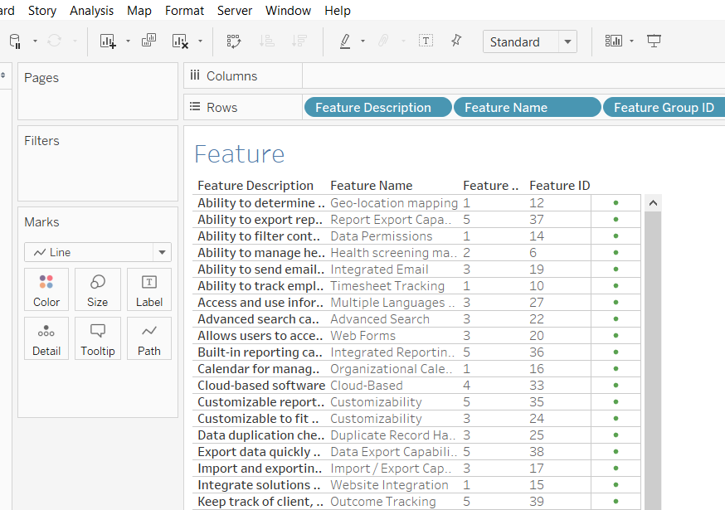
Bedrock Front End
Data Analytics

Slide 22
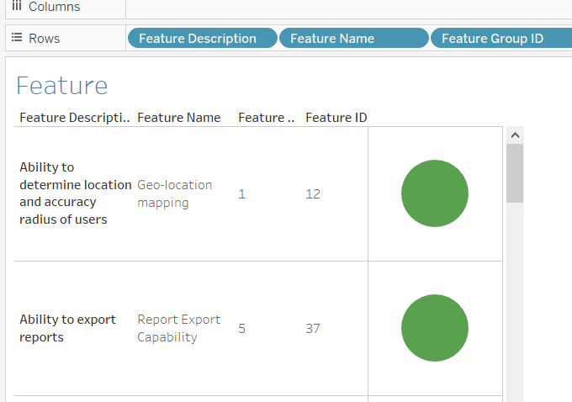
Bedrock Front End
Data Analytics

Slide 23
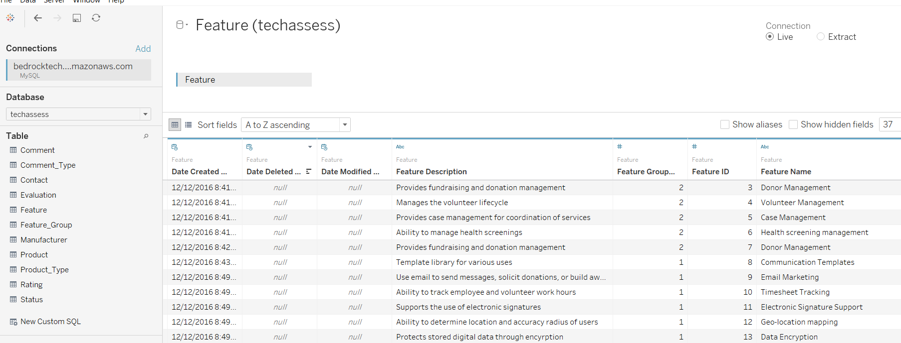
Bedrock Front End
Data Tab

